Slide 1

Bike rental demand Analysis
Nexthikes it solutions
By Shivani sharma

Slide 2

Objective
Analyze bike sharing data to make recommendation for improving the business model.
Study the impact of weather, holidays, season, time on rentals identify trends that help improve bike availability and business planning.

Slide 3
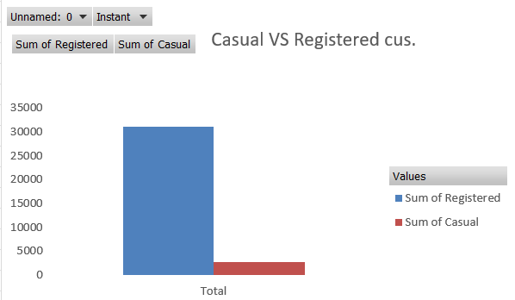
Casual vs registered customers
The bike rental dataset shows that registered users account for the majority of bike rentals. There were a total of 31,152 registered rentals compared to 2,746 casual rentals.
Registered users contribute approximately 92% of total rentals, while casual users account for about 8%.
Key Insight: This indicates that the bike-sharing service is primarily used by regular customers, while casual users contribute a much smaller share of total demand.

Slide 4
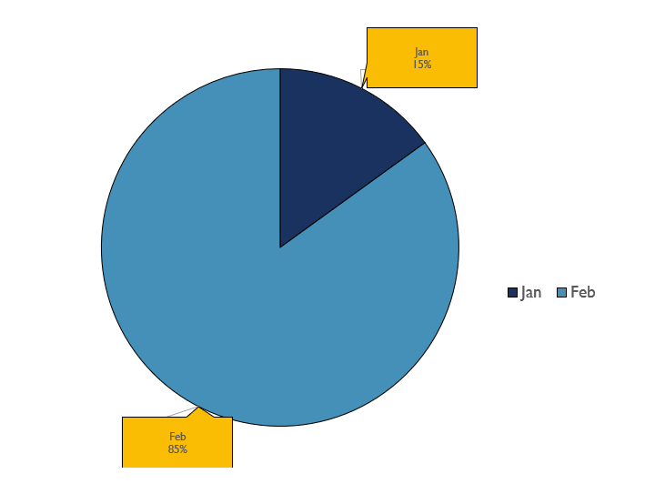
Months vs rentals
Rental VS Month
January: Lowest rentals (327 casual, 3,964 registered).
February: Strong increase in demand (1,848 casual, 18,267 registered).
Key Insight: Registered users dominate bike rentals, while casual rentals also increase as the year progresses.
This indicates that bike usage started growing after January, with registered users consistently contributing the majority of rentals.

Slide 5
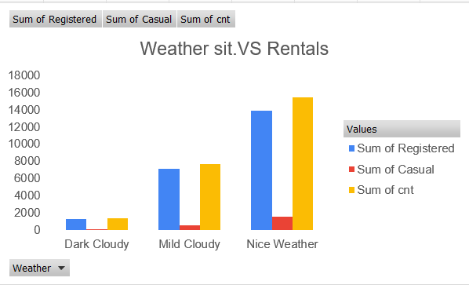
Weather situation vs rentals
Nice Weather: Highest rentals (15,400), indicating ideal conditions for biking.
Mild Cloudy: Moderate rentals (7,680).
Dark Cloudy: Lowest rentals (1,326), showing that poor weather discourages bike usage.
Key Insight: Better weather leads to higher bike rental demand, and registered users make up the largest share of rentals in every weather condition.
This indicates that Bike rentals were highest during Nice Weather conditions, with a total of 15,400 rentals (13,832 registered and 1,568 casual users).

Slide 6
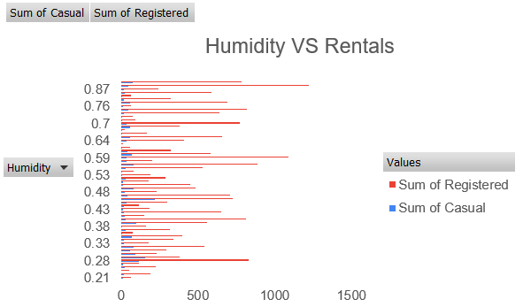
Humidity VS Rentals
The analysis shows a positive relationship between temperature and bike rentals. As the temperature increases, both casual and registered bike rentals generally increase. Registered users consistently account for the majority of rentals across all temperature levels. The highest rental activity is observed at moderate to warm temperatures (around 0.56–1.00), while lower temperatures (0.21–0.35) have significantly fewer rentals.
Key Insides : This indicates that people are more likely to use bike-sharing services in warmer weather.

Slide 7
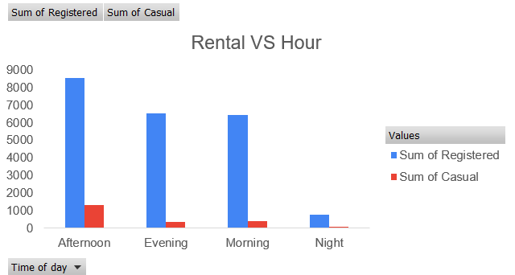
Rental VS hour
The highest number of rentals occurs in the afternoon, with 8,511 registered users and 1,335 casual users. Morning and evening also experience strong demand, mainly from registered users, while night records the lowest rentals with only 767 registered and 86 casual users.
Key Insight : This indicates that bike usage is highest during the daytime and decreases significantly at night.

Slide 8
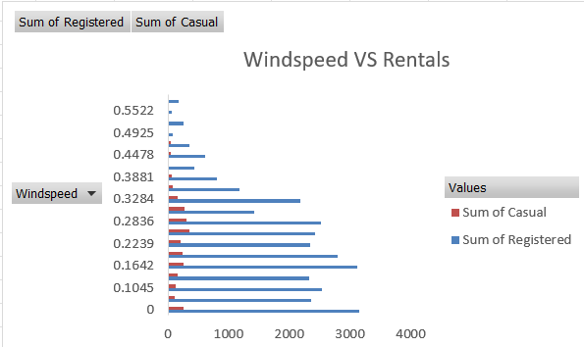
Windspeed vs rentals
The highest rental activity is observed at low wind speed values (0.00–0.28), where registered users consistently exceed 2,300 rentals. As wind speed becomes stronger (above 0.35), both registered and casual rentals decline noticeably. High wind conditions discourage people from using bike-sharing services.
Key Insight: This indicates that bike rentals generally decrease as wind speed increases. wind speed levels, registered users remain the primary contributors to total rentals.

Slide 9
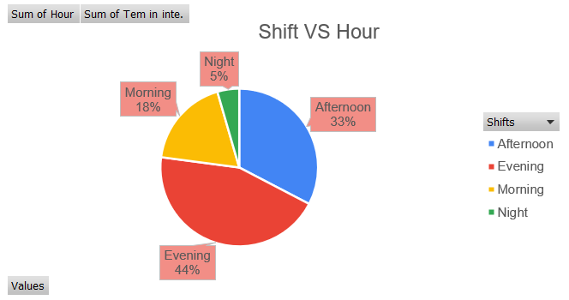
Shifts vs hour
The analysis shows that the afternoon has the highest cumulative temperature, making it the warmest period of the day. Morning and evening experience moderate temperatures, while night has the lowest overall temperature. These temperature patterns help explain why bike rental demand is typically higher during the daytime and lower at night, as riders generally prefer warmer and more comfortable weather conditions.

Slide 10
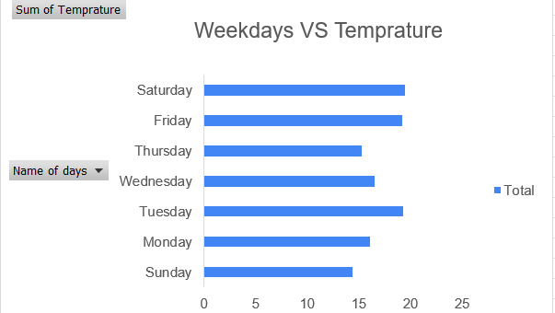
The analysis of average temperature by weekday shows noticeable variation throughout the week. Saturday recorded the highest average temperature (19.46°C), followed closely by Tuesday (19.22°C) and Friday (19.18°C). In contrast, Sunday had the lowest average temperature (14.40°C).. Temperatures remained moderate during the week, with warmer conditions toward the end of the week, which may contribute to increased outdoor activities such as bike rentals.
Key Insight: Warmer days can encourage higher bike rental demand, while cooler days may result in comparatively lower usage.

Slide 11
Conclusion
The Bike Rental Demand Analysis shows that bike rental usage is influenced by a combination of weather conditions, temperature, wind speed, time of day, seasonality, and user type. The analysis reveals that registered users are the primary users of the bike-sharing system, This indicates that the service is mainly used by regular commuters rather than occasional riders. This suggests that users prefer riding during daylight hours when weather and visibility are more comfortable.
Monthly analysis indicates that rentals increased from January to February, showing the beginning of higher demand as weather conditions improved. Temperature analysis by weekday also shows that Saturday, Tuesday, and Friday were the warmest days, which may contribute to increased outdoor activities and bike usage.
"By analyzing customer behavior and environmental factors, bike-sharing companies can make informed decisions to improve service quality, increase customer satisfaction, and maximize rental demand."

Slide 12
Thank You
Here I came to the end of this project on the topic “BIKE RENTALS DEMANDS ANALYSIS.
I have shared my work while doing this project. I learnt many new things about this project and it wonderful learning experience for me while working on this project.
This project increased my research thinking skill and interest in this project.
Nexthikes I t solution

